Slide 1



Complete Database Security
Thomas Kyte
http://asktom.oracle.com/
Notes:
1

Slide 2

Agenda
Enterprise Data Security Challenges
Database Security Strategy
Oracle Database Security Solutions
Defense-in-Depth
Q&A

Slide 3

Top Priority for IT Security?
Data security remains the top priority for enterprise IT security shops with 89% of enterprises citing it as a critical or high priority. Enterprises are also continuing to focus on cutting costs and increasing efficiency.
Source: Forrester - The State Of Enterprise IT Security And Emerging Trends: 2009 To 2010

Slide 4
More data than ever…
Two Thirds of Sensitive and Regulated Data Resides in Databases…
Growth Doubles Yearly
1,800 Exabytes
2006
2011
Source: IDC, 2008

Slide 5

More breaches then ever…
PUBLICLY REPORTED DATA BREACHES
Total Personally Identifying Information Records Exposed (Millions)
Source: DataLossDB
Once exposed, the data is out there – the bell can’t be un-rung
Remediation Cost Exceeds $300/record
Notes:
Source: DataLossDB http://datalossdb.org

Slide 6
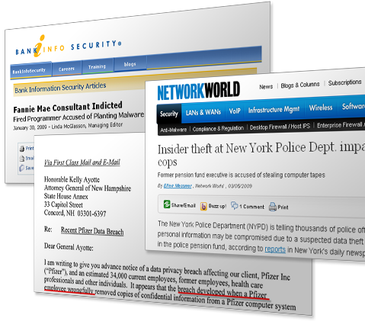
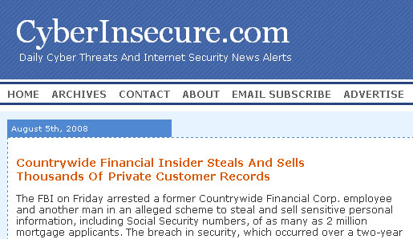
More threats than ever…
Insider Fraud Is Involved in 60% of Data Breaches
Source: Wall Street & Technology
Notes:
http://online.wsj.com/article/SB123249174099899837.html

Slide 7

More regulations than ever…
UK/PRO
Criminal Prosecution
Civil Liability
PIPEDA
EU Data Directives
Government Sanctions
Sarbanes-Oxley
GLBA
PCI
201CMR17
Basel II
Breach Disclosure
Euro SOX
K SOX
FISMA
J SOX
HIPAA
ISO 17799
SAS 70
COBIT
AUS/PRO
90%
Companies behind in compliance
Source: IT Policy Compliance Group

Slide 8





Database Security Defense In Depth
Oracle Database Security Solutions
Monitor and block threats before they reach databases
Track changes and audit database activity
Control access to data within the database
Prevent access by non database users
Remove sensitive data from non production environments
Monitoring & Blocking
Auditing
Access
Control
Encryption & Masking
Database Firewall
Audit Vault
Total Recall
Configuration Management
Database Vault
Label Security
Identity Management
Advanced Security
Secure Backup
Data Masking
Notes:
19-Sep-11
Oracle Confidential
8

Slide 9


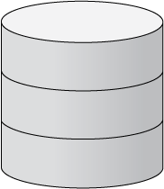













Oracle Database Firewall First Line of Defense
Allow
Log
Alert
Applications
Substitute
Block
Alerts
Built-in
Reports
Custom
Reports
Policies
Monitor database activity to prevent unauthorized database access, SQL injections, privilege or role escalation, illegal access to sensitive data, etc.
Highly accurate SQL grammar based analysis without costly false positives
Flexible SQL level enforcement options based on white lists and black lists
Scalable architecture provides enterprise performance in all deployment modes
Built-in and custom compliance reports for SOX, PCI, and other regulations

Slide 10
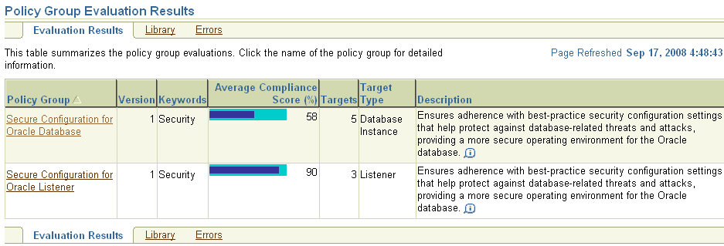
Oracle Configuration Management Secure Your Database Environment
Monitor
Discover
Classify
Assess
Prioritize
Fix
Monitor
Asset Management
Policy Management
Vulnerability
Management
Configuration Management
& Audit
Analysis &
Analytics
Discover and classify databases into policy groups
Scan databases against 400+ best practices and industry standards, custom enterprise-specific configuration policies
Detect and event prevent unauthorized database configuration changes
Change management dashboards and compliance reports
Notes:
19-Sep-11
Oracle Confidential
10
10
10

Slide 11


Oracle Total Recall Track Changes to Sensitive Data
select salary from emp AS OF TIMESTAMP
'02-MAY-09 12.00 AM‘ where emp.title = ‘admin’
Transparently track application data changes over time
Efficient, tamper-resistant storage of archives in the database
Real-time access to historical application data using SQL
Simplified incident forensics and recovery

Slide 12








Oracle Audit Vault Audit Database Activity in Real-Time
!
Alerts
HR Data
Built-in
Reports
CRM Data
Audit Data
ERP Data
Custom
Reports
Databases
Policies
Auditor
Consolidate database audit trail into secure centralized repository
Detect and alert on suspicious activities, including privileged users
Out-of-the box compliance reports for SOX, PCI, and other regulations
E.g., privileged user audit, entitlements, failed logins, regulated data changes
Streamline audits with report generation, notification, attestation, archiving, etc.
Notes:
19-Sep-11
Oracle Confidential
12

Slide 13








Oracle Database Vault Enforce Security Policies Inside the Database
SecurityDBA
Application
DBA
Procurement
Application
HR
Finance
select * from finance.customers
DBA
Automatic and customizable DBA separation of duties and protective realms
Enforce who, where, when, and how using rules and factors
Enforce least privilege for privileged database users
Prevent application by-pass and enforce enterprise data governance
Securely consolidate application data or enable multi-tenant data management
Notes:
19-Sep-11
Oracle Confidential
13
13
13

Slide 14
Oracle Label Security Classify Data and Users to Automate Access Control
Sensitive
Confidential
Transactions
Public
Report Data
Reports
Confidential
Sensitive
Classify users and data based on business drivers
Database enforced row level access control
Users classification through Oracle Identity Management Suite
Classification labels can be factors in other policies

Slide 15


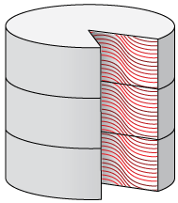









Oracle Advanced Security Protect Data from Unauthorized Users
Disk
Backups
Application
Exports
Off-Site
Facilities
Complete encryption for application data at rest to prevent direct access to data stored in database files, on tape, exports, etc. by IT Staff/OS users
Efficient application data encryption without application changes
Built-in two-tier key management for SoD with support for centralized key management using HSM/KMS
Strong authentication of database users for greater identity assurance
Notes:
19-Sep-11
Oracle Confidential
15
15
15

Slide 16
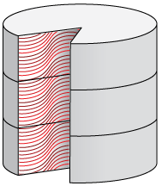

Oracle Data Masking Irreversibly De-Identify Data for Non-Production Use
Production
Non-Production
LAST_NAME | SSN | SALARY
AGUILAR | 203-33-3234 | 40,000
BENSON | 323-22-2943 | 60,000
LAST_NAME | SSN | SALARY
ANSKEKSL | 111—23-1111 | 60,000
BKJHHEIEDK | 222-34-1345 | 40,000
Data never leaves Database
Make application data securely available in non-production environments
Prevent application developers and testers from seeing production data
Extensible template library and policies for data masking automation
Referential integrity automatically preserved so applications continue to work

Slide 17
Oracle Database Security Solutions
Complete Defense-in-Depth
Comprehensive – single vendor addresses all your requirements
Transparent – no changes to existing applications or databases
Easy to deploy – point and click interfaces deliver value within hours
Cost Effective – integrated solutions reduce risk and lower TCO
Proven – #1 Database with over 30 years of security innovation!
Monitoring & Blocking
Auditing
Access
Control
Encryption & Masking
Database Firewall
Audit Vault
Total Recall
Configuration Management
Database Vault
Label Security
Identity Management
Advanced Security
Secure Backup
Data Masking
Notes:
19-Sep-11
Oracle Confidential
17

Slide 18
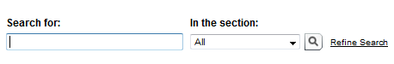
For More Information
search.oracle.com
database security
or
oracle.com/database/security
Notes:
18

Slide 19
Q
&
A
Thomas.Kyte@oracle.com

Slide 20


Slide 21
The following is intended to outline our general product direction. It is intended for information purposes only, and may not be incorporated into any contract. It is not a commitment to deliver any material, code, or functionality, and should not be relied upon in making purchasing decisions. The development, release, and timing of any features or functionality described for Oracle’s products remains at the sole discretion of Oracle.

